Slide 1
第六讲 Polytomous Logistic Regression

Slide 2
Polytomous Logistic Regression
The dependent variable has three or more categories and is nominal or ordinal.
Multinomial logistic regression and the proportional odds model are two of the most common models.
Multinomial logistic regression, which makes no assumptions regarding the relationship between the categories, and is most appropriate for nominal outcomes
The proportional odds model, which assumes an ordering to the categories and is most appropriate for ordinal outcomes

Slide 3
Multinomial logistic regression
Multinomial logit (probit) models Nominal outcomes –
no intrinsic order (qualitative)
Three or more unordered categories
Examples:
Smoking status – never, current, former smoker
Marital status – married, divorced, widowed, never married

Slide 4
In general, we will assume there are J response categories.
Then for the ith observation, there will be J binary response variables, Y_{i1},…, Y_{iJ，} where:
Or for the ith observation, there will be J response variables, Y_{i1},…, Y_{iJ，} where:

Slide 5
Estimates a series of binary logit (probit) models
One group is chosen to be the base (reference) category for the other groups (estimates equations for L – 1 groups)
Example: If never smokers are the base category, then two models are estimated:
Current smokers vs. Never smokers
Former smokers vs. Never smokers

Slide 6
Multinomial logistic regression
Let j=1 denote the reference category
Fit separate logistic regression models for j=2,…, L, comparing each outcome to the baseline:
Note that this will result in L-1 vectors of regression coefficients (we don’t need to estimate the Lth vector because

Slide 7
The fitted class probabilities for an observation are therefore

Slide 8
The logits for any other comparisons can be obtained from them.
In general, to compare category k and m, we have

Slide 9
Maximum Likelihood Estimation
Two approaches:
Separate binary logistic regressions are carried out for each of the J-1 comparisons to the baseline category. For example, to estimate β₂ , we drop from the data set all cases except those for which either Y_{i1}=1 or Y_{i2}=1, then we can apply binary logistic regression directly.
Or we base on the likelihood for the full data set to get the maximum likelihood estimates of β₂ ,…, β_{J} .

Slide 10
Goodness of fit
Summary statistics for goodness of fit are analogous to those for Binomial logistic regression:

Slide 11
Deviance for model comparison
For nested two models,

Slide 12
Pseudo R square
which represents the proportional improvement in the log-likelihood function due to the terms in the model of interest, compared with the minimal model.

Slide 13
Other goodness of fit statistics: AIC and BIC
AIC and BIC are other goodness of fit statistics based on the log-likelihood function with adjustment for the number of parameters estimated and for the amount of data.
The model with the smaller value of AIC or BIC would be preferred.

Slide 14
Example: Car preferences
Y: importance of air conditioning and power steering. There are three categories: No or little importance, Important, Very important.
The category “no or little” importance is chosen as the reference category.
X: age and sex.

Slide 15
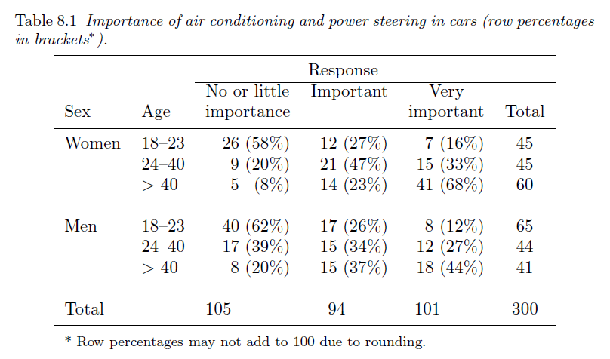

Slide 16
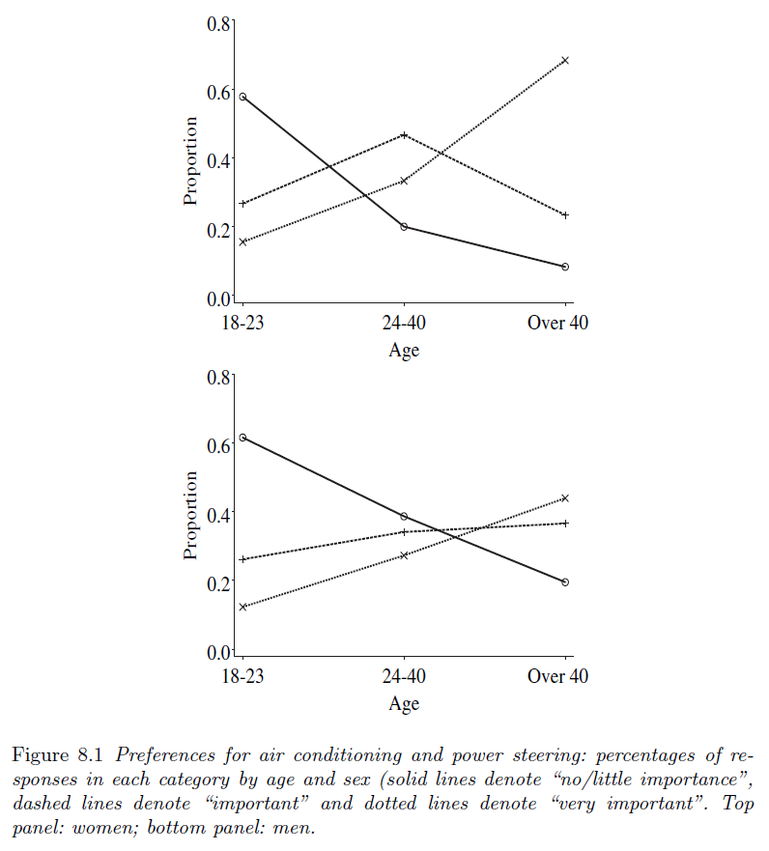

Slide 17
Model fitting
The maximum value of the log-likelihood function for the minimal model (with only two parameters, β₀₂ and β₀₃) is −329.27 and for the fitted model is −290.35,
Pseudo R²=？AIC=?
The maximum value of the log-likelihood function for the maximal model is −288.38.
The deviance for the fitted model?

Slide 18
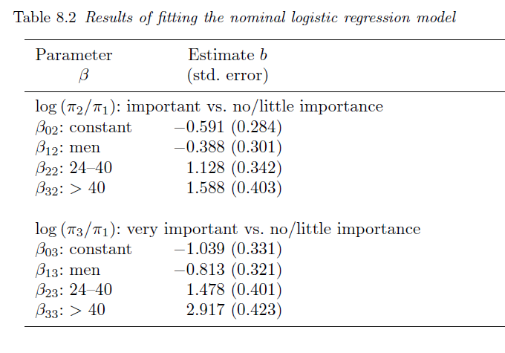
Question: the probabilities for the preference of women aged 18-23?
the probabilities for the preference of men aged 24-40?

Slide 19
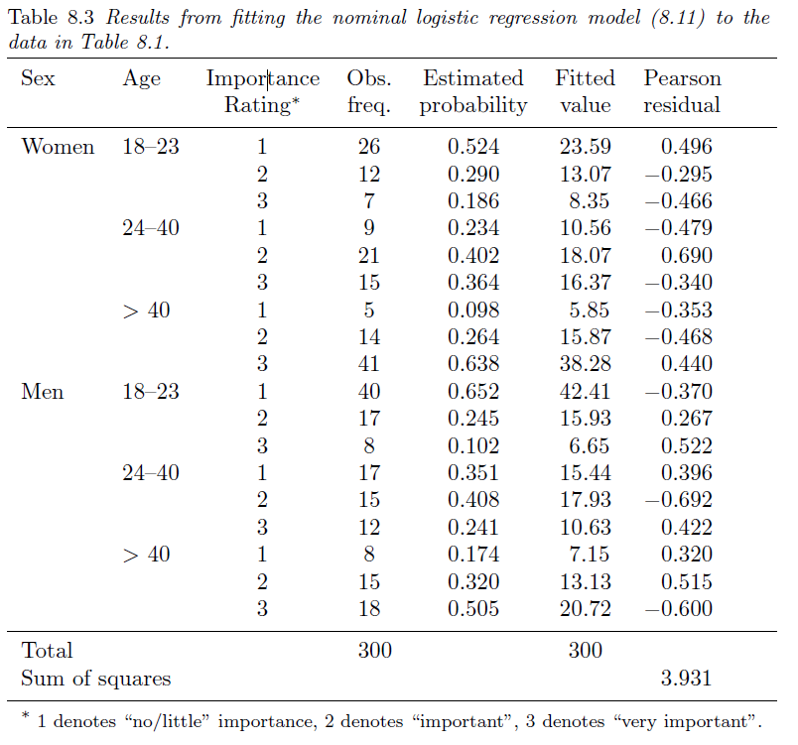

Slide 20
Ordered logistic model
If there is an obvious natural order among the response categories then this can be taken into account in the model specification.
The example on car preferences provides an illustration as the study participants rated the importance of air conditioning and power steering in four categories from “not important” to “very important”. Ordinal responses like this are common in areas such as market research, opinion polls and fields such as psychiatry where “soft” measures are common (Ashby et al. 1989).

Slide 21
We assume rating (Z) is a hidden continuous variable.

Slide 22
Maximum Likelihood Estimation
We base on the likelihood for the full data set to get the maximum likelihood estimates of β₀₁ ,…, β_{0(J-1),} β₁,… ,β_{p.}

Slide 23
This is called the proportional odds model. It is based on the assumption that the effects of the covariates x₁,…,x_{p-1} are the same for all categories on the logarithmic scale. That is, the odds ratio for a one unit change in x is the same for all response categories.

Slide 24
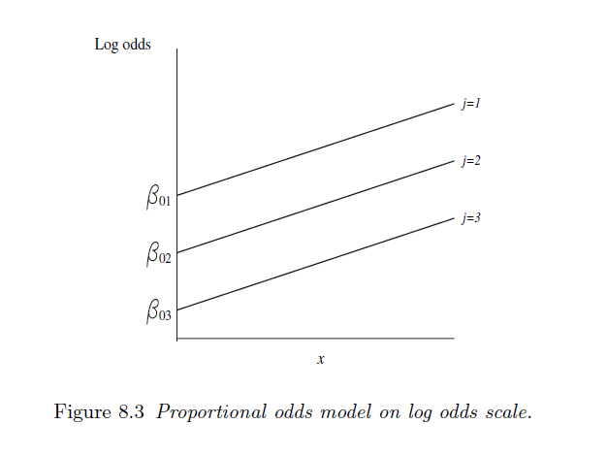

Slide 25
Example: Car preferences
The response variable for the car preference data is , of course ordinal. The following proportional odds model was fitted to these data:

Slide 26
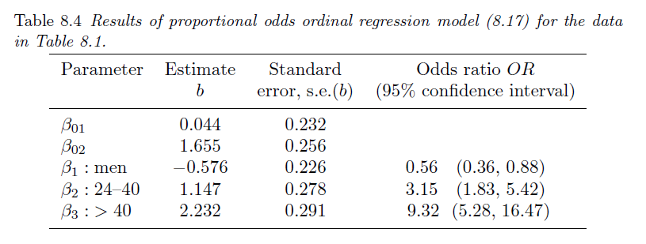
The maximum value of the log-likelihood function for the minimal model (with only two parameters, β₀₁ and β₀₂) is −329.27 and for the fitted model is −290.648,
Pseudo R²=？AIC=?
The maximum value of the log-likelihood function for the maximal model is −290.648.
The deviance for the fitted model?
Question: the probabilities for the preference of women aged 18-23?
the probabilities for the preference of men aged 24-40?

Slide 27
For this example, the proportional odds logistic model for ordinal data
and the nominal logistic model produce similar results. On the grounds of parsimony, proportional odds model would be preferred because it is simpler and takes into account the order of the response categories.
Model diagnostic using such as residuals and cook’s distance are analogous to those for Binomial logistic regression:

Slide 28
Comments
Although the models described in this chapter are developed from the logistic regression model for binary data, other link functions such as the probit or complementary log-log functions can also be used. Logits and probits are appropriate if the distribution is symmetric but the complementary log-log link may be better if the distribution is very skewed.
If there is doubt about the order of the categories, then nominal logistic regression will usually be a more appropriate model than any of the models based on assumptions that the response categories are ordinal. Although the resulting model will have more parameters and hence fewer degrees of freedom and less statistical power, it may give results very similar to the ordinal models (as in the car preference example).

